Slide 1


Slide 2
Agenda
Introduction
Data Visualisation & Insights
Recommendations & Next steps
Acknowledgement

Slide 3
Introduction
This project analyzes the performance of students and teachers in Information Technology (IT) in Sub-Saharan Africa. It explores various factors influencing IT education, including curriculum design, teacher training, resources, and infrastructure. It also identifies the strengths, weaknesses, challenges, and proposes recommendations for improvement.

Slide 4
Goal
To improve the quality of Information Technology (IT) education in Sub-Saharan Africa by assessing student-teacher performance, identifying challenges, and proposing effective strategies for enhancing IT learning outcomes and bridging the digital divide.
This goal encompasses the broader objective of achieving SDG 4 (Quality Education) by focusing specifically on IT education in Sub-Saharan Africa.

Slide 5
Planning
Presentation
Data Understanding
Data Analysis
1
2
3
4
5
Data Cleaning
Data Visualisation

Slide 6
Results and Discussion

Slide 7
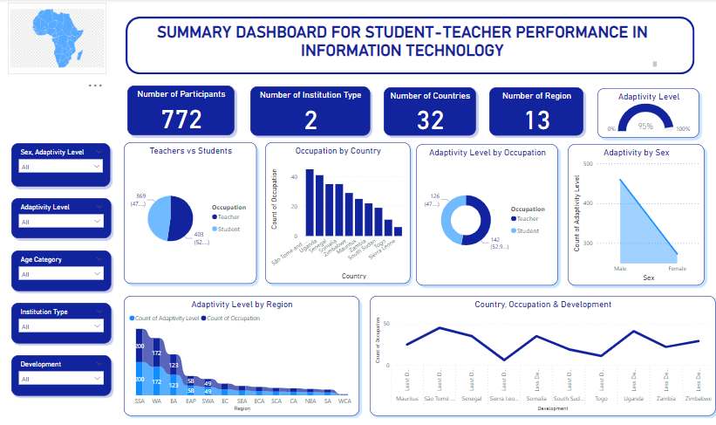

Slide 8
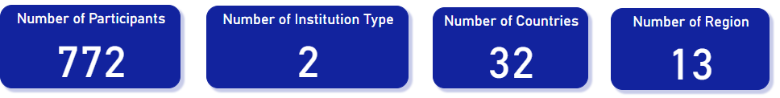
Data Visualisation & Insights
From the Visualisation above, We can see that the:
Total Number of Participants is 772,
Number of Institution Type is 2,
Number of Countries is 32,
Number of Region is 12.

Slide 9
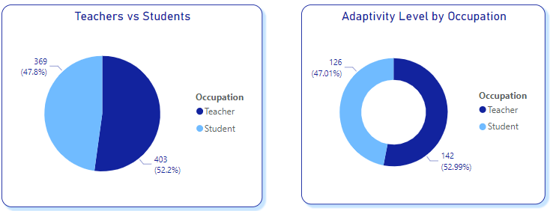
Data Visualisation & Insights
52 .2% of the participants are teachers and 47.8% of the participants are students.
The adaptivity level for teachers in their occupation is 52.99%, indicating a relatively high level of adaptability than students (47.01%).

Slide 10
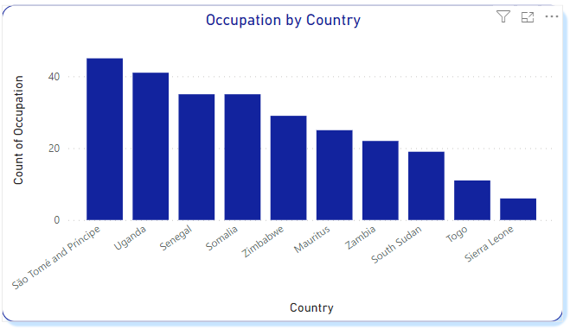
Data Visualisation & Insights…

Slide 11
Limitations
Limited Availability of Sufficient and Reliable Data
One of the key challenges encountered in the project "Analysis of Student-Teacher Performance in Information Technology across Sub-Saharan Africa" is the limited availability of sufficient and reliable data.
Gathering comprehensive and accurate data across multiple countries or regions in Sub-Saharan Africa can be a complex and time-consuming task.
This challenge hinders the ability to conduct a comprehensive analysis of student-teacher performance in IT education and can impact the validity and reliability of the findings and recommendations.

Slide 12
Conclusion & Recommendations

Slide 13
Conclusion & Recommendations
Limited Availability of Sufficient and Reliable Data

